Slide 1


The Howard County Doula Training & Mentorship Initiative
P.E.A.C.E. Project
In Partnership w/ Sweet Bee Services

Slide 2
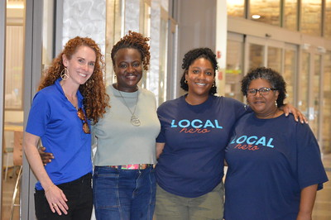
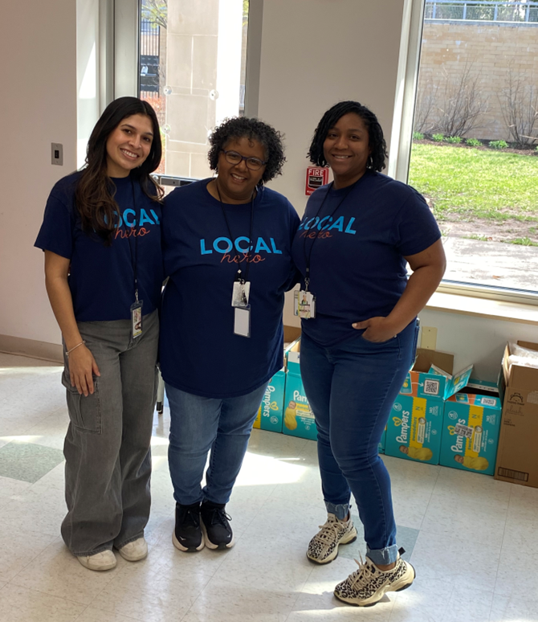
P.E.A.C.E. Project
The Perinatal Equity and Care for Everyone (P.E.A.C.E.) Project provides care coordination for clients, families and professionals by connecting them with information about prenatal, postpartum and infant resources available in Howard County.
Services provided at no cost to the client.
There are no income or medical requirements to participate in the program.
Notes:
The Perinatal Care Navigator assists clients, families or providers in determining which services best meet the client’s needs and interests. The navigator will then link the client to community resources/services and will follow-up on the outcome of the referral.
Launched in July 2023 as part of County Executive Ball’s 3-year initiative to expand Maternal & Infant Health services in the county. Since the launch, the P.E.A.C.E. Project has served almost 40 women.
Partnership with MOMCares to train doulas that live in Howard County. Cohort 1 completed training on 11/19/2023 and began providing services in January. Cohort 2 completed training on 03/10/2024.
Services provided at no cost to the client. There are no income or medical requirements
Care Coordination connects expecting people and persons in the postpartum period to medical, social, and educational services to improve birth outcomes. Coordinating care can prevent complications in normal pregnancies, particularly in communities that exhibit disproportionately high health risks: low-income, racial/ethnic minority, and isolated populations.
Connecting patients to resources
Avoiding duplication of services
Improving communication between patients and healthcare staff
Avoiding operating in silos
Care coordination has been helpful in pregnancies complicated by opioid use disorder and complex social problems
MOM Maryland Medicaid program

Slide 3

P.E.A.C.E. Project
Assistance locating childcare
Childbirth/parenting education
Teen parenting support referral
Insurance eligibility
Pregnancy options counseling
Pregnancy loss support
Doula Support
Pregnancy resources
Home visiting referral
Locating a provider/specialist
WIC referral
Parenting support resources
Emotional/mental health resources
Links to community resources

Slide 4
Sweet Bee Services
Sweet Bee Services is the only Medicaid-approved doula training organization based in Baltimore, Maryland, offering both concierge-level client care and equitable access through Medicaid. We provide culturally responsive, trauma-informed training and mentorship designed to center birth equity and professional readiness. As the region’s only full-spectrum doula agency with integrated mentorship and job placement, we are building a diverse, supported workforce to transform maternal health outcomes from the ground up.
Notes:
The Perinatal Care Navigator assists clients, families or providers in determining which services best meet the client’s needs and interests. The navigator will then link the client to community resources/services and will follow-up on the outcome of the referral.
Launched in July 2023 as part of County Executive Ball’s 3-year initiative to expand Maternal & Infant Health services in the county. Since the launch, the P.E.A.C.E. Project has served almost 40 women.
Partnership with MOMCares to train doulas that live in Howard County. Cohort 1 completed training on 11/19/2023 and began providing services in January. Cohort 2 completed training on 03/10/2024.
Services provided at no cost to the client. There are no income or medical requirements
Care Coordination connects expecting people and persons in the postpartum period to medical, social, and educational services to improve birth outcomes. Coordinating care can prevent complications in normal pregnancies, particularly in communities that exhibit disproportionately high health risks: low-income, racial/ethnic minority, and isolated populations.
Connecting patients to resources
Avoiding duplication of services
Improving communication between patients and healthcare staff
Avoiding operating in silos
Care coordination has been helpful in pregnancies complicated by opioid use disorder and complex social problems
MOM Maryland Medicaid program

Slide 5
Who
Through a partnership with Howard County Health Department (P.E.A.C.E. Project) Sweet Bee Services will train and mentor Three community-based Doulas during the Fall 2025 Medicaid-approved cohort.
  Training is priced at 2,500.00 & mentorship is priced at 1,200.00
  P.E.A.C.E. Project will cover 90% of the training for three participants
  Participants will have a contribution of 350.00
Notes:
There is no specific number of movements that is considered normal, a change in your baby’s movement is what is important.- Free Count the Kicks App

Slide 6
Where
Cohort In-person Launch Event September 5, 2025 (TBD)
Hybrid Doula Training September 6, 2025-October 11, 2025
Hybrid Mentorship Program (October 18, 2025- November 22, 2025)
Notes:
There is no specific number of movements that is considered normal, a change in your baby’s movement is what is important.- Free Count the Kicks App

Slide 7
What will you Learn…
Doula History, Scope of Work, and Practice
Understanding Physiological Birth & Nutrition Needs for Birthing People
High-Risk Pregnancies, Birth Trauma, and Emergency Preparation
Person-Centered Care: Reproductive Justice, Inclusivity, and Family Engagement
Postpartum Care: Newborns, NICU, Mental Health, and Well-being
The Business of Being a Doula: How to Start and Grow Your Practice
Notes:
There is no specific number of movements that is considered normal, a change in your baby’s movement is what is important.- Free Count the Kicks App

Slide 8
How
Complete Application by deadline July 30th, 2025
Interviews will be on held on August 5th and August 6th
You will be notified of your acceptance on August 7th, 2025
Notes:
There is no specific number of movements that is considered normal, a change in your baby’s movement is what is important.- Free Count the Kicks App

Slide 9
Doula Partnership Program
The Doula Partnership Program supports the network of certified and Medicaid credentialed doulas serving Howard County. Certified doulas working in Howard County that enroll in the program will receive in-depth Medicaid credentialing and billing training as well as have access to:
  Promotion & Marketing through HCHD Network
  Ongoing Client Referrals
  Client Screening & Coordination
  Continuing Education & Training
  Quarterly Meet-Ups & Networking Opportunities

Slide 10
Medicaid Resources Available
Medicaid Credentialing Resources for Doulas
  Doula Medicaid Credentialing Manual
  Doula Medicaid Credentialing Checklist
  Doula Medicaid Credentialing and Billing Training

Slide 11
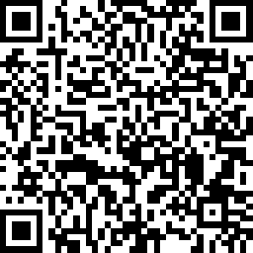
Contact US
If you or someone you know is interested in the Fall 2025 Doula training, please contact the P.E.A.C.E. Project!
Phone: 410-313-7540
E-mail: HCHDPeace@howardcountymd.gov
Website: https://www.howardcountymd.gov/peace-project
Notes:
There is no specific number of movements that is considered normal, a change in your baby’s movement is what is important.- Free Count the Kicks App

