Slide 1

Submitting a Zoning Application in ProjectDox
User Guide

Slide 2
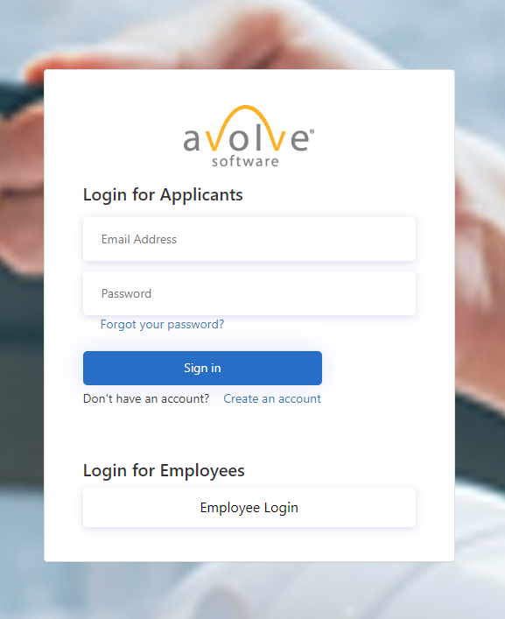
Log In to ProjectDox
Step 1.
Visit ProjectDox Plan Submission: Howard County, Maryland
Step 2.
Log in using Email Address and Password
Use “Forgot your password?” if unable to login but have an existing account
New users: Use “Create an account” option to sign up for a new account

Slide 3
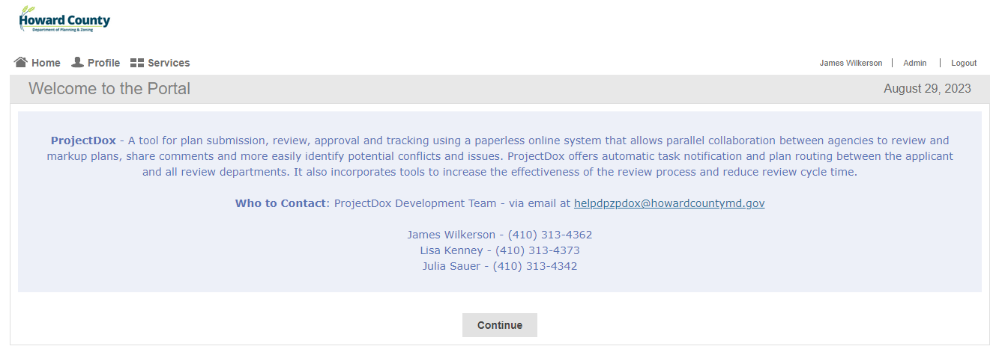

Opening the Portal
Home, Services, and Continue button will all take you to the “Services” page, where applications can be accessed.

Slide 4
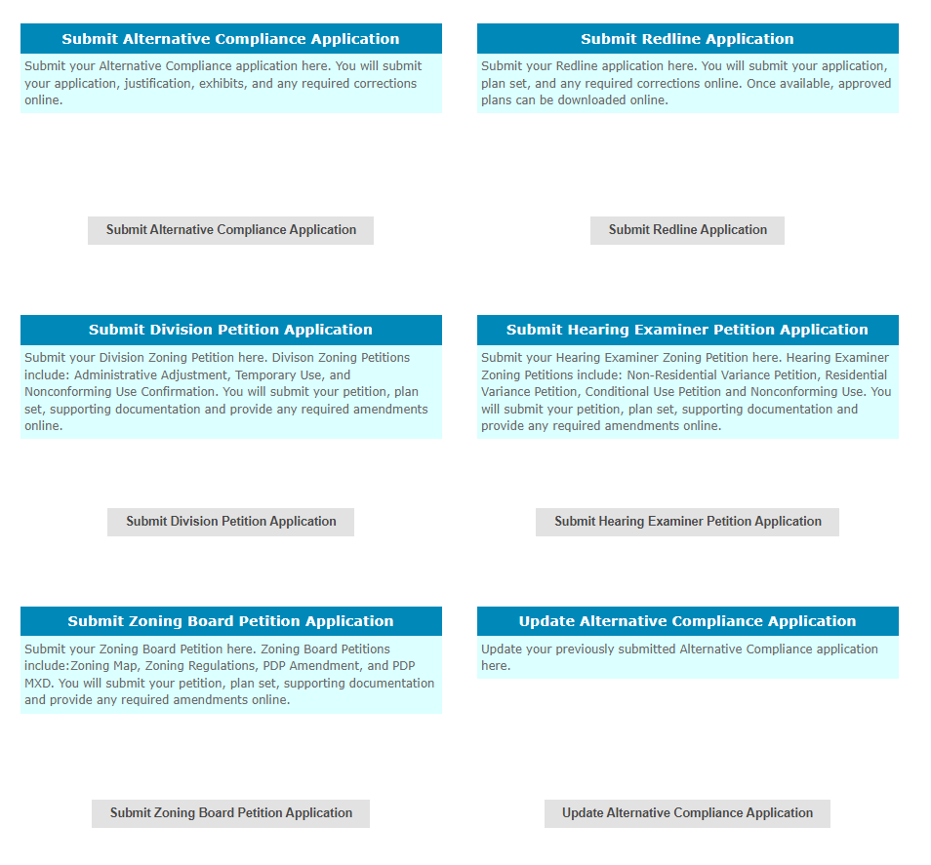
Services Screen
Click “Go To ProjectDox” to directly access existing projects and perform tasks
Choose the appropriate Zoning Petition type to begin submission process

Slide 5
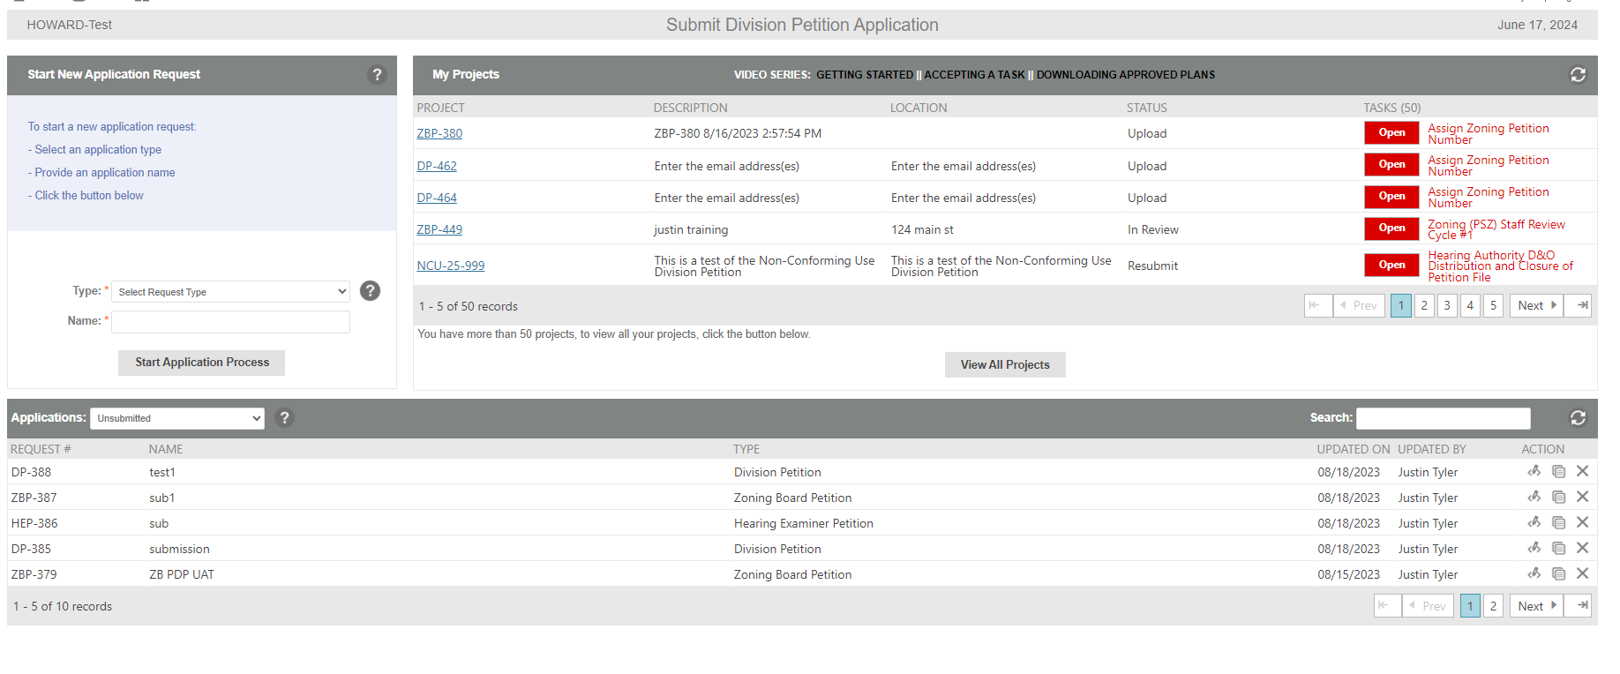


Submit A Zoning Petition Application
  Use “Select Request Type” dropdown to choose “Petition Type”
  Name project
  and click “Start Application Process”
  Access active projects and tasks or find completed projects
  “View All Projects” takes you to standard ProjectDox view of projects
  Review submitted and unfinished applications

Slide 6
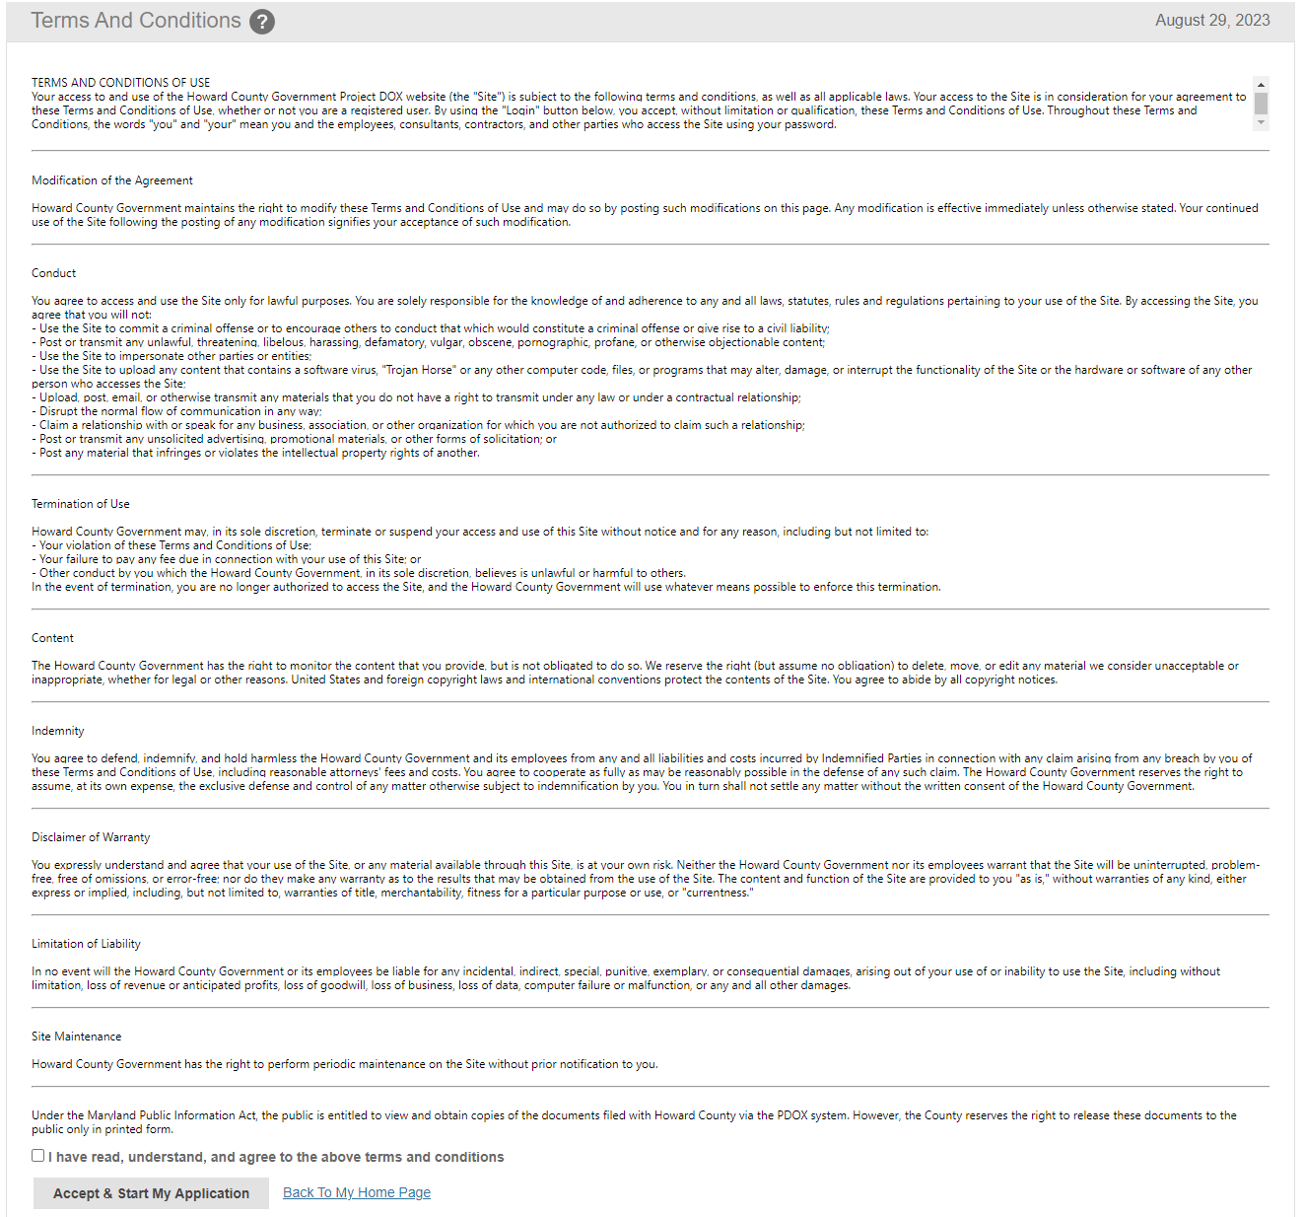
Terms and Conditions
Step 1.
Review the pertinent information
Step 2.
Check the box acknowledging your understanding and agreement
Step 3.
Click “Accept and Start My Application”

Slide 7
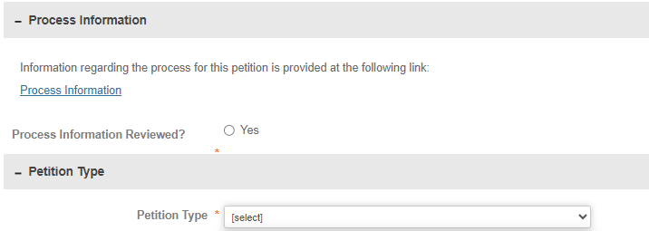
Zoning Petition Application Form
Step 1.
Review and acknowledge the Process Information. Be sure to fill in all fields marked with a red asterisk * as those are required fields
Step 2.
Select within the drop-down menu, the applicable Petition type

Slide 8
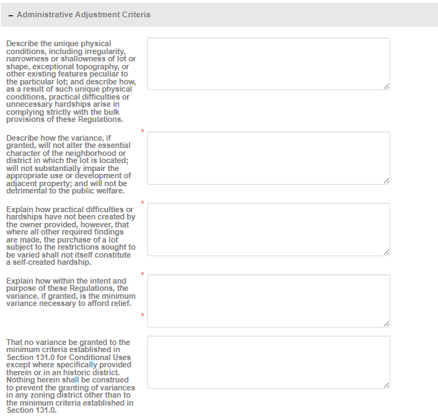
Zoning Petition Criteria Form
Provide a response to the Petition criterion. Be sure to fill in all fields marked with a red asterisk * as those are required fields

Slide 9
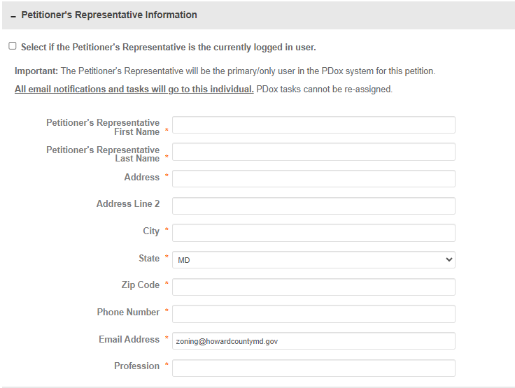
Petitioner’s Representative Information
Step 3.
If you are the Petitioner’s Representative, simply check the box at the top of the section to autofill the fields using the information in your user profile
Note:
The Petitioner’s Representative will be the primary/only user in the PDox system for this Petition and this role cannot be re-assigned if box is checked
If Petitioner has no representation, fill in the petitioners contact for this section

Slide 10
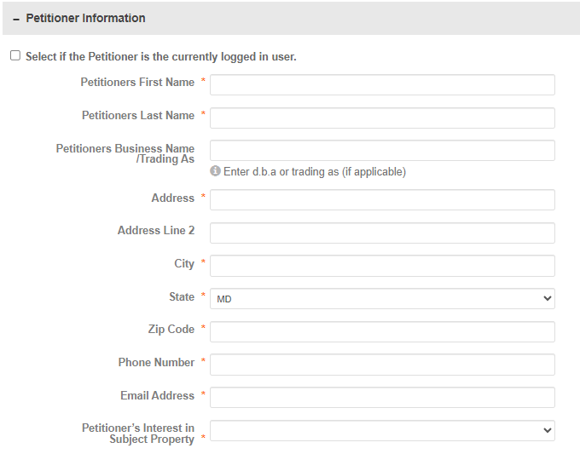
Petitioner’s Information
Step 4.
If you are the Property Owner and/or Petitioner, simply check the box at the top of the section to autofill the fields using the information in your user profile
Provide the required Petitioner information for the Zoning Petition
Select the appropriate relationship in the Subject Property in the dropdown

Slide 11
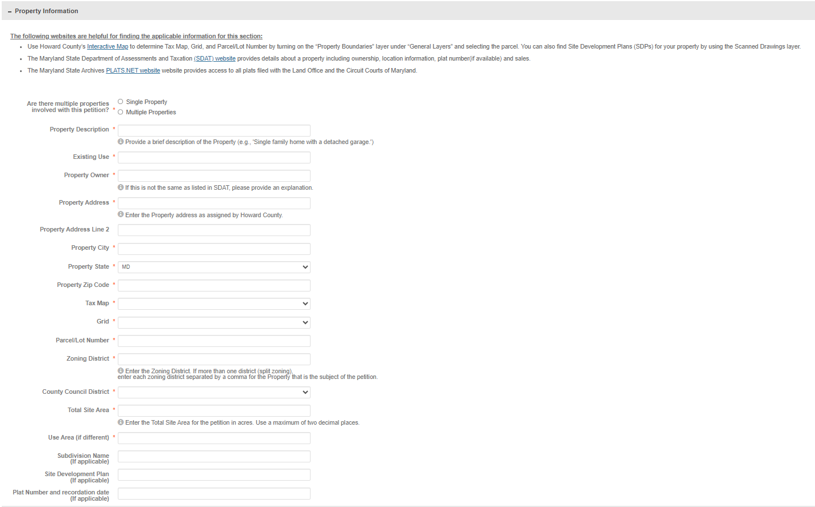
Property Information
Step 5.
Use the Howard County Interactive Map to determine Tax Map, Grid and Parcel/Lot Number
The SDAT link provides property ownership information
Be sure to complete all fields marked with a red asterisk * as those are required fields

Slide 12
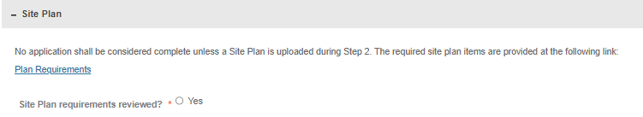
Site Plan Requirements
Step 6.
Review and acknowledge the Site Plan requirements
*The site plan will get uploaded during the 2nd step of the submission process. An email providing instructions for file uploads will follow the initial submission

Slide 13
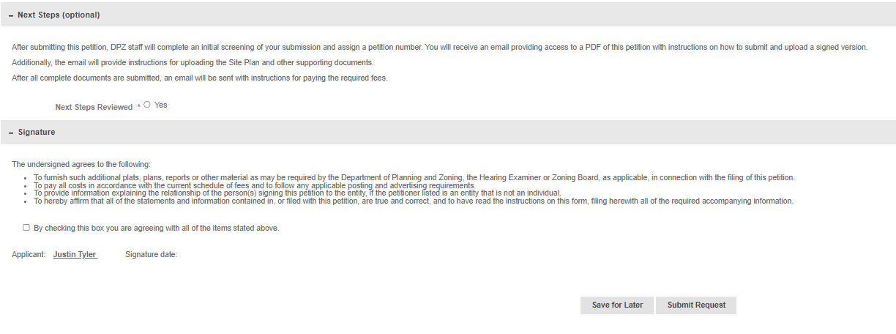
Save or Submit the Application
Step 7.
Review and acknowledge the Next Steps process. A follow up emailing containing upload instructions will follow the initial submission
Step 8.
Acknowledge and submit the request when the form is complete or save for later if more information is still needed

Slide 14
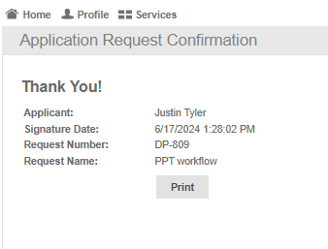
Submission Confirmation
This screen means the submission was successful
You will receive an email containing a PDF copy of your application and acknowledging receipt
*The print button will only print out this confirmation page

Slide 15
Who to Contact for Assistance
  Whom do I contact if I experience technical issues?
  James Wilkerson – jwilkerson@howardcountymd.gov or 410-313-4362
  Whom do I contact regarding questions about the plan types and submission requirements?
  Justin Tyler – jtyler@howardcountymd.gov or 410-313-4415

